Slide 1
ENC conversion -
UKHO observations
July 2021

Slide 3
Overview
S-57 3.1 to S-101 1.0 - manual intervention
IHO conversion guidance observations

Slide 4
S-57 3.1 to S-101 1.0 - manual intervention
Definitions of RAG
 | S-57 3.1 to S-101 1.0
Green (68%) | Convert successfully
Amber (20%) | May need minor manual intervention and is identified by current generic validation tests*
Red (12%) | A requirement to look at the checklist or revisit the DCEG (unable to rely on current validation to identify) AND/OR needs significant manual intervention
*Includes 'Red' items downgraded based on number of Features and regularity of updates

Slide 5
‘Red’ Features
22 of 202 Features
S-101 Feature | S-57 equivalent
BuoyEmergencyWreckMarking
CautionArea | CTNARE
DataCoverage | M_COVR
DeepWaterRoute
DiscolouredWater | CTNARE
DockArea | DOCARE**
FairwayAuxiliary
FloatingDock | FLODOC
Hulk | HULKES**
InformationArea | M_NPUB
Landmark | LNDMRK
S-101 Feature | S-57 equivalent
LocalDirectionofBuoyage | M_NSYS
LockBasin | LOKBSN**
NavigationalSystemOfMarks | M_NSYS
OffshorePlatform | OFSPLF
PhysicalAISAidtoNavigation
Pontoon | PONTON**
RestrictedAreaNavigational | RESARE
RestrictedAreaRegulatory | RESARE
SeabedArea | SBDARE
TidalStreamPanelData | TS_PAD
VesselTrafficServiceArea
*blanks denote new Features/Aggregations/Associations

Slide 6
Categorisation of Issues
Category | Example
Manual population of mandatory attributes required | Max/Min display scale in DataCoverage (M_COVR)
Attributed correctly in S-57 but not created in S-101 | BOYSPP to BuoyEmergencyWreckMarking
Incorrect aggregation | DeepWaterRoute
Deletion of unnecessary Feature | Information Objects (DiscolouredWater created from CTNARE),
New SoE Feature | DockArea
No longer SoE Feature | Pontoon (Area)
New association required | FairwayAuxiliary
Additional attributes not mapped to associated Feature | Flare stack on OffshorePlatform
New Feature in S-101 | PhysicalAISAidtoNavigation
Manual check required | Information Objects
Notes:
Manual population of mandatory attributes required e.g. max/min display scale in DataCoverage following conversion of M_COVR, MARSYS in LocalDirectionofBuoyage (MARSYS not populated in S-57 if ORIENT populated in M_NSYS, MARSYS in NavigationalSystemOfMarks, Reference tide type (TidalStreamPanelData)
New Features in S-101 attributed correctly in S-57 but are not created e.g. BOYSPP to BuoyEmergencyWreckMarking, ADMARE (VTS in INFORM) to VesselTrafficServiceArea
Incorrect aggregation – e.g. DeepWaterRoute
Deletion of unnecessary Feature e.g. Information Objects (DiscolouredWater created from CTNARE), Landmark (Pile – new Boolean ‘in the water’ attribute)
New SoE Feature, Hole in LNDARE required e.g. DockArea, LockBasin
New association required e.g. FairwayAuxiliary
No longer SoE Feature, DEPARE fill required, e.g. FloatingDock, Hulk, Pontoon (Area)
Additional attributes not mapped to associated feature, e.g. flare stack on OffshorePlatform
New Feature in S-101 e.g. PhysicalAISAidtoNavigation
“All Information objects need to be checked for correct attribution”
BOYSPP - potential to add to mapping file based on colour
Deep water route aggregation – future validation test could cover
PhysicalAISAidtoNavigation – could be added to mapping file

Slide 7
Top ‘6’ ish* – Manual Intervention
SBDARE
PONTON, FLODOC, HULKES
TS_PAD
RESARE
CTNARE/Information Types/External Files
* Based on total Features affected and resource required to fix

Slide 8
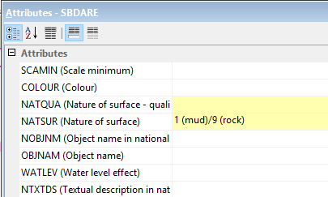
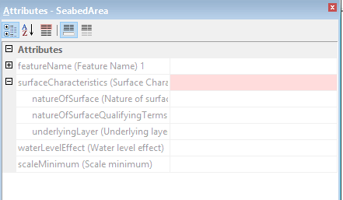
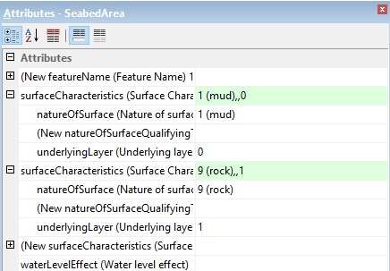
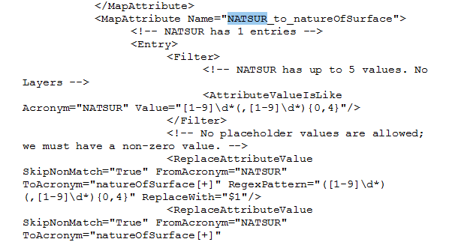
SBDARE
S-57
Conversion to S-101
Layered Seabed Areas are not converting and must be attributed manually. They are flagged by validation.
Correct S-101 encoding

Slide 9
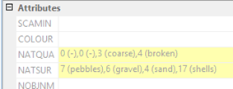

SBDARE
Conversion to S-101
S-57
Mixed Seabed Areas with 4 or more NATSUR and at least 1 NATQUA are not converting and must be attributed manually. They are flagged by validation.
Notes:
June Update – CARIS to investigate as part of mapping file amends in line with release of S-101 FC v1.0.1

Slide 10
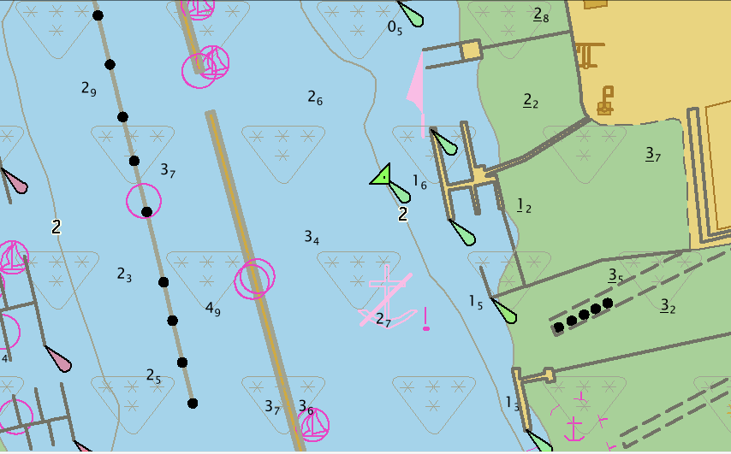
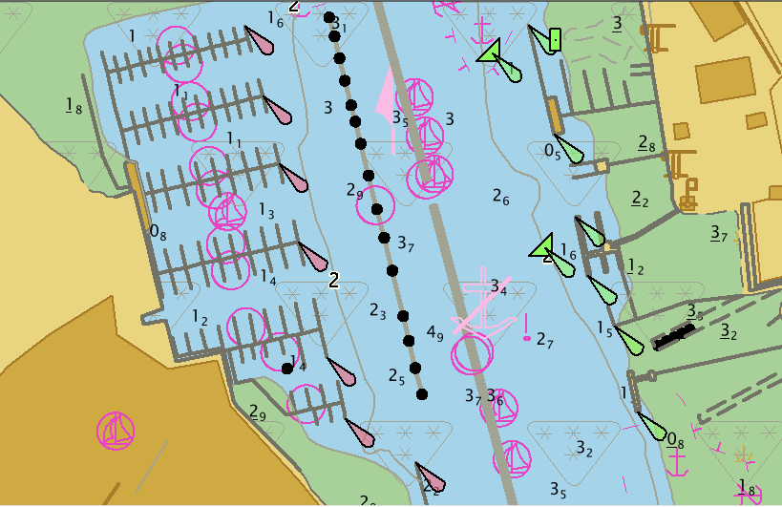
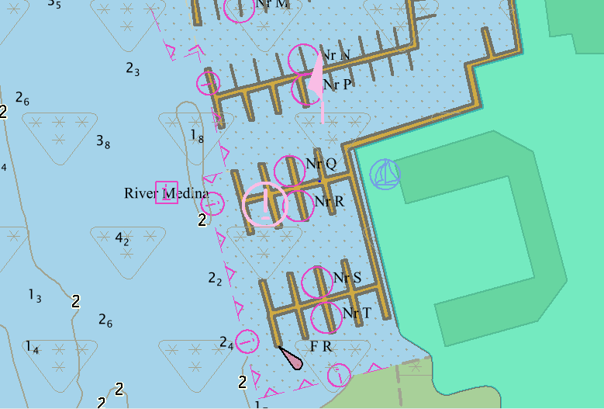
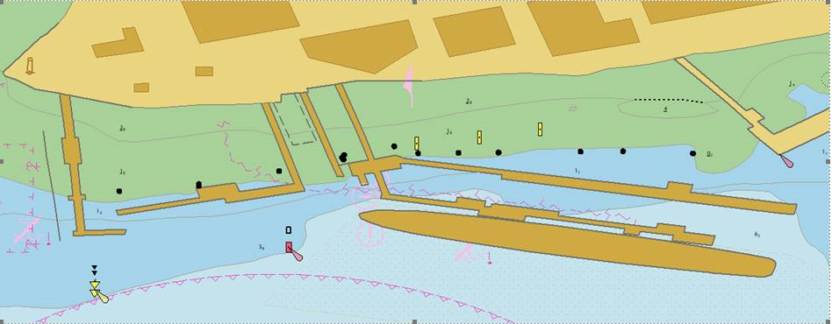
PONTON, FLODOC & HULKES (No longer SoE Features)
PONTON floating barriers & berthing PONTONS intersecting DEPCNT's & COALNE
Numerous PONTON features straddling DEPARE's & DEPCNT's
Associated complexity where there are multiple intersecting features or features sharing edges
Numerous PONTONS sharing with COALNE
HULKES and PONTON features requiring SoE infilling

Slide 11
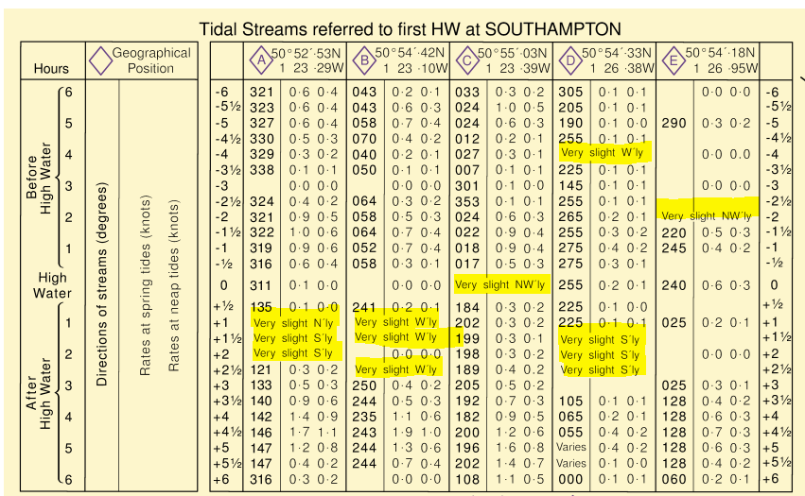
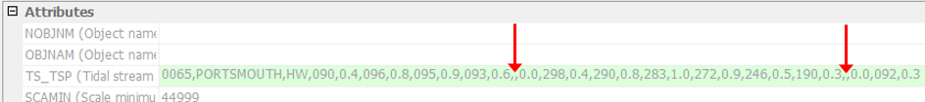
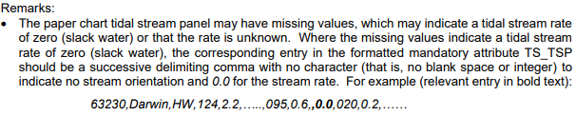
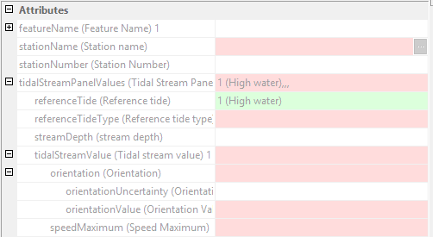
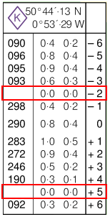
TS_PAD
TS_PAD features containing 'null' orientation/speed values results in no conversion
Adding ‘zero’ to the S-57 TS_TSP text string goes against the encoding guidance in the UOC
TS_TSP maps to an Information Object, even though the text string has been successfully converted to a complex attribute
Notes:
May Update – DCEG 1.01 updated to account for slack water where original TS_TSP is included as ‘0’ – ‘where an encoded complex attribute tidal stream vale, sub-attribute speed maximum has a value of zero (indicating slack water), the corresponding sub-attribute orientation / orientation value must be populated with an empty (null) value’.
June Update – CARIS confirmed TS_TSP maps to an Information Object as a safety net currently to investigate as part of mapping file amends in line with release of S-101 FC v1.0.1

Slide 12
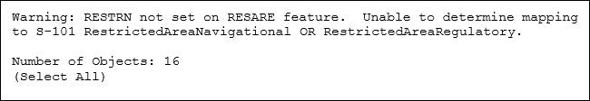
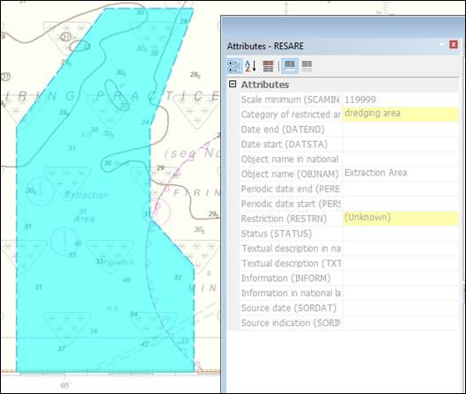
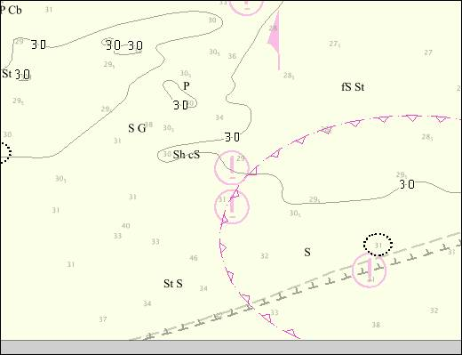
RESARE
Restriction(RESTRN) 'Unknown' results in no Feature being created.
S-57
S-101

Slide 13
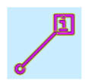
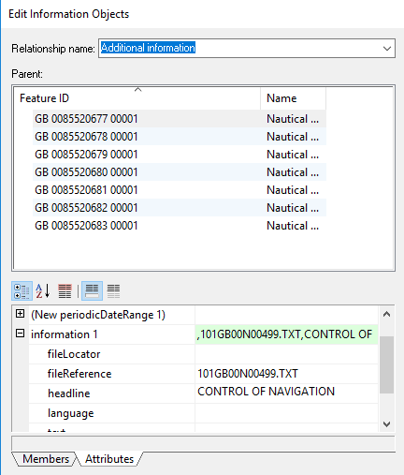
CTNARE/Information Type/External Files
Duplicated Features created in conversion (where only TXTDSC and INFORM attributes were encoded in S-57)
Resulting in, multiple CautionAreas with no attribution but the same geometry
Manual Intervention required…
All Information Types need to be checked for correct attribution
- Alternative encoding now available?
- Duplicated (e.g. spelling)?
2. All Features with a TXTDSC
- Renaming & Re Linking of External Files

Slide 14
IHO Conversion Guidance – UK observations
Feature | Agreement | Comments
DataCoverage | - | Guidance doc states that Max display scale will be auto populated, this was not the case due to UK converting data not cells
BuoyEmergencyWreckMarking | N | This did not convert automatically using CARIS mapping file – raised with CARIS
DeepWaterRoute | N | No mention of existing S-57 aggregations being mapped to a Traffic Sep aggregation instead of a Deep water route one
DiscolouredWater | N | Caution area with 'Discoloured water' in INFORM in S-57. Unnecessary creation of Information Type which would require deleting
DockArea & LockBasin | N | Guidance doc states “The geometry of the S-57 Group 1 coverage will be “cookie cut” to incorporate the geometry of the Dock Area, and the associated features amended accordingly”. Change the statement to must be to cover all conversion tools (CARIS conversion did not automate this)

Slide 15
IHO Conversion Guidance – UK observations
Feature | Agreement | Comments
FairwayAuxilary | N | FairwayAuxiliary aggregation is not mentioned in the Conversion document – manual creation of associations required
Hulk | N | No mention of changes to skin of the earth features and having to fill in holes in geometry
NavigationalSystemOfMarks | - | Instances of M_NSYS where ORIENT is populated will convert to Local Direction of Buoyage but there is no mention that you will need to populate MARSYS (Marks Navigational- System of) as it is now mandatory.
PhysicalAISAidtoNavigation | N | Nav Aid Object fails to convert even if INFORM is populated with "Automatic Identification System (AIS) aid to navigation“. Text string is just added to an Information Type (this is optional encoding in UOC, not currently included in CARIS mapping file).

Slide 16
IHO Conversion Guidance – UK observations
Feature | Agreement | Comments
RestrictedAreaNavigational & RestrictedAreaRegulatory | N | Guidance doc states “Where RESTRN is not present or is populated with an empty (null) value, the RESARE will be converted to a Restricted Area Regulatory feature.” No Feature was created if RESTRN set to NULL (differences in conversion tool?)
SeabedArea | N | No specific mention of bottom quality underlying layer with which we have observed issues. Raised with CARIS
TidalStreamPanelData | - | Significant remarks, further review required
VesselTrafficServiceArea | - | S-57 ADMARE features previously populated with any information relevant to vessel traffic service areas won't automatically transfer and convert these features to the new VesselTrafficServiceArea feature if incorrectly formatted, i.e. 'Vessel Traffic Service Area’ not correctly added to INFORM

Slide 17
IHO Conversion Guidance – UK observations
Feature | Agreement | Comments
CautionArea | Y
FloatingDock | Y
Information Area | Y
Landmark | Y
LocalDirectionofBuoyage | Y
OffshorePlatform | Y
Pontoon | Y

Slide 18
Thank you

